Slide 1
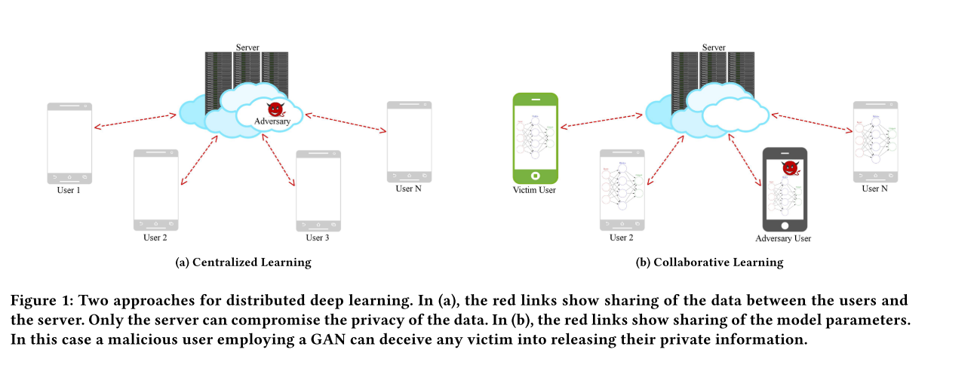
Question

Slide 2
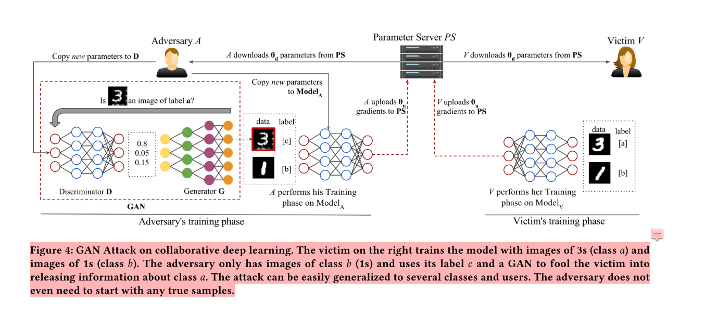
Proposed Attack

Slide 3
GAN
noise
genreator
data sample
discrimination
generator sample
Yes/No

Slide 4
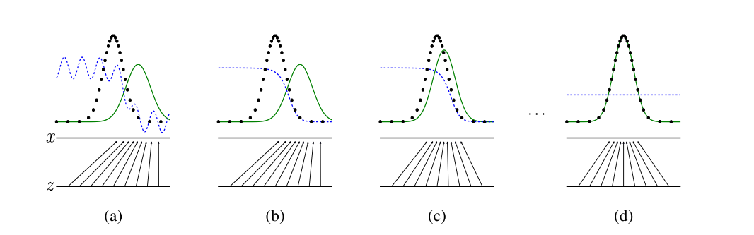
GAN
Black：generating distribution
Blue：discriminative distribution
Green：generative distribution
Z：noise

Slide 5
End
Thank you

